Slide 1
BUILDING BETTER Autonomous Machines with Jetson
Dustin Franklin | Barrett Williams | Robotics | Technical Marketing
barrettw@nvidia.com | dustinf@nvidia.com
Cambridge Developer Meetup
January 20, 2016
Notes:
Hello everyone, thank you for coming, and thanks to Middlesex Lounge for hosting us this evening. I’m Dustin –and I’m Barrett -- and we’re a Developer Evangelists with the Jetson team at NVIDIA. Since there’s lots of food, drinks, and people to meet, we’ll keep this short, sweet, and to the point.
Describe outline:
Identity and Markets
Previously Unsolvable Problems
The Tools to Create Amazing

Slide 2

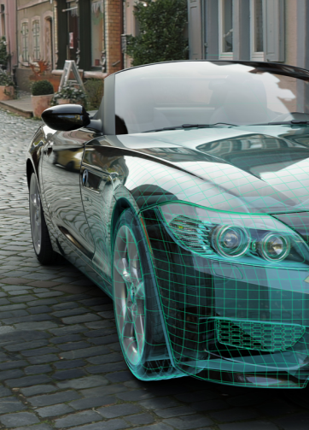
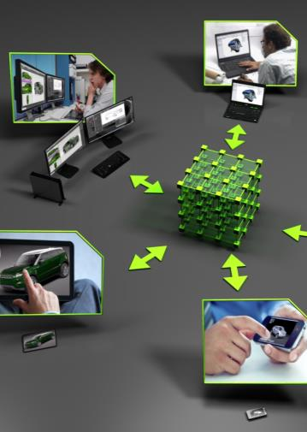
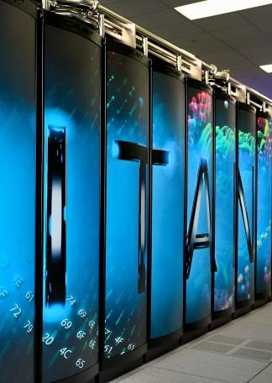
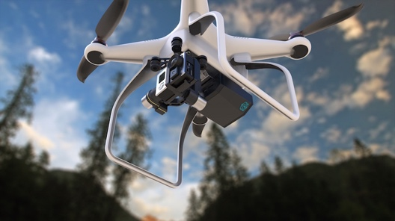
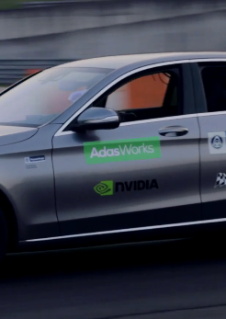
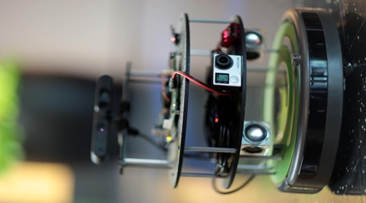
The world leader in visual computing
GAMING
DESIGN
ENTERPRISE VIRTUALIZATION
HPC & CLOUD SERVICE PROVIDERS
AUTONOMOUS MACHINES

Slide 3
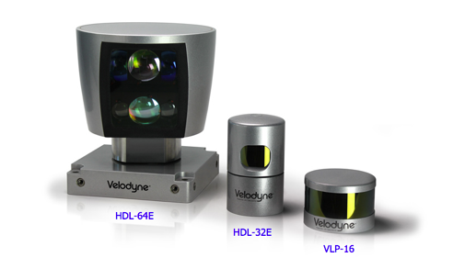
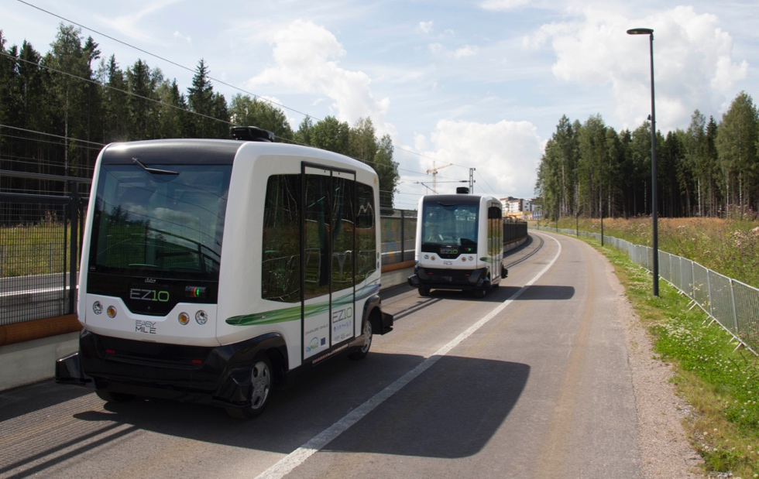
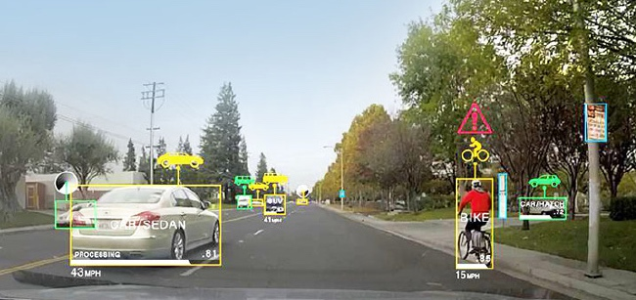
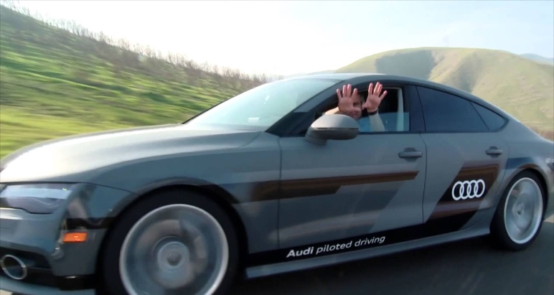
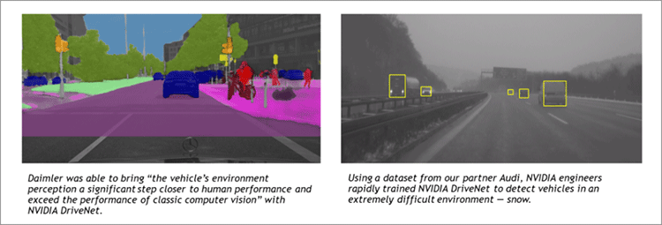
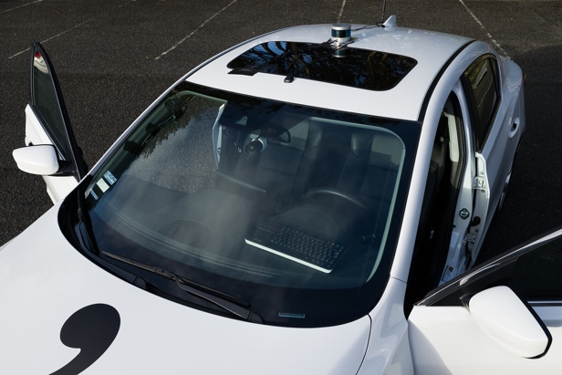
Autonomous Driving
Spurring on Research in Sensors, Vision, Operating Systems
WEpod EZ10 autonomous shuttle
Robust automotive heritage
VisionWorks
cuDNN
DRIVENet
Notes:
Why is autonomy important? (Remove slide and replace with corporate intro.)
An exciting area of growth that is pushing the envelope today in embedded computing, is self-driving vehicles. NVIDIA is a central provider of compute technology for many of the outfits researching and deploying this. It’s powered by the same CUDA-enabled GPU architecture underneath.
The WEPod EZ10 actually uses Jetson TK1 inside, and is the first driverless people mover. It’s hitting the roads today in the Netherlands.
Quanergy, Velodyne, SICK

Slide 4
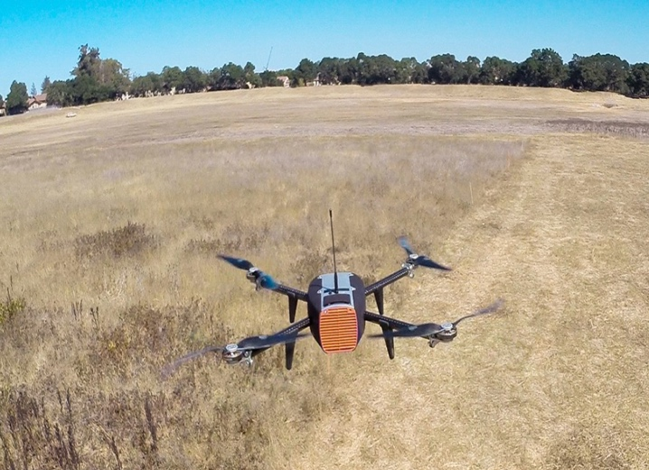
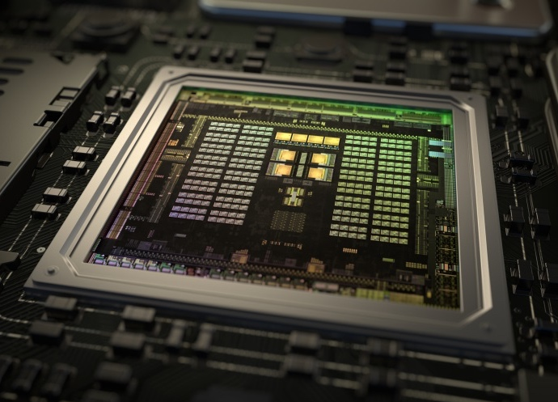
AI And the Frontier of autonomous machines
New use cases demand autonomy
Onboard sensing and deep learning enable autonomy
GPUs deliver superior performance and efficiency
x₁
x₂
x₃
x₄
Notes:
We’re collectively here today because I believe many of us share a vision about the ubiquity of AI and autonomy in the 21st century. NVIDIA’s role in this is to provide accessible, high-performance visual computing platforms to enable the work of developers everywhere. And like many of you, we’re always searching for the latest and greatest empowering tech out there.
First pane:
Examples:
Drone Delivery (easy in remote areas with GPS, hard in dense, complex, urban scenarios)
Construction Faults (smokestacks, power lines; mistakes could be costly)
One place we can look is GPUs. GPUs provide the nexus between performance, programmability, and deployability.

Slide 5
Meet Jetson
Notes:
Let’s take a look at the extensive tools & support ecosystem built around Jetson.

Slide 6
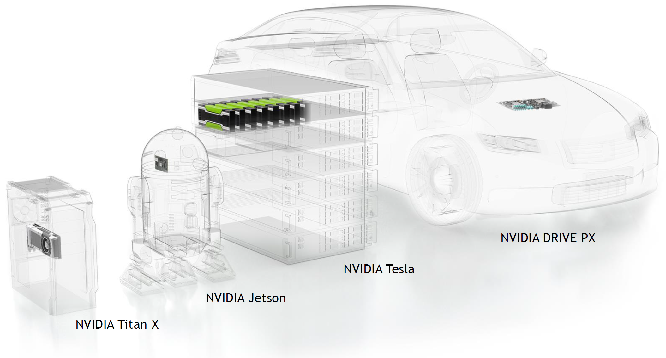
ONE ARCHITECTURE — END-TO-END AI
PC GAMING
CUDA + Linux throughout the stack.
Notes:
You are probably familiar with (or have heard of) NVIDIA’s larger graphics cards and datacenter accelerators. Since 2014, NVIDIA has operated a shared architecture with commonality between the GPUs across all of it’s products. There’s Titan X for PC, Tesla for the Cloud, and DRIVE PX for automotive.
And the smallest and most compact of these offerings is the credit-card sized Jetson module. It’s built around the Tegra X1 processor and geared for deployment in the embedded space, all the while maintaining software compatibility with it’s larger siblings.

Slide 7
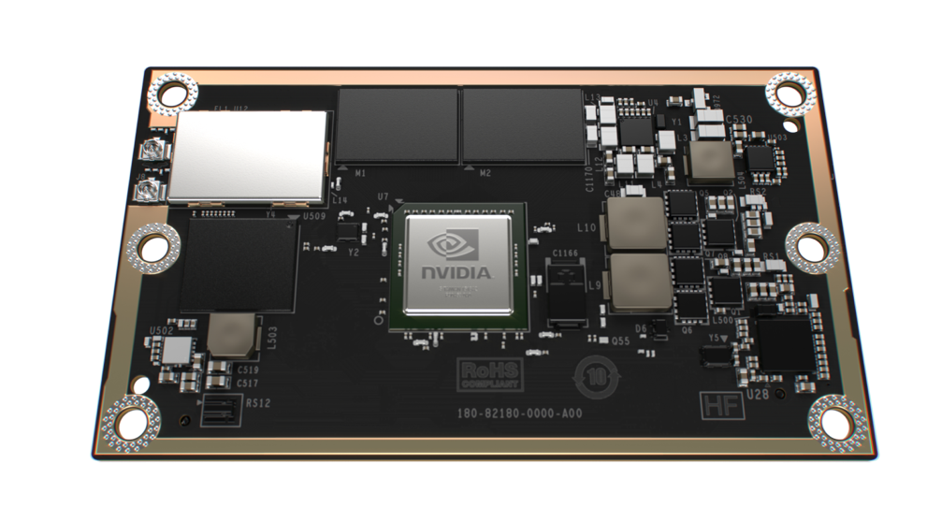
 | Jetson TX1
GPU | 1 TFLOP/s 256-core Maxwell
CPU | 4x 64-bit ARM A57 CPUs
Memory | 4 GB LPDDR4 | 25.6 GB/s
Video decode | 4K 60Hz H.264
Video encode | 4K 30Hz H.264
CSI | Up to 6 cameras | 1400 Mpix/s
Display | 2x DSI, 1x eDP 1.4, 1x DP 1.2/HDMI
Wi-Fi | 802.11 2x2 ac
Networking | 1 Gigabit Ethernet
PCI-E | Gen 2 1x1 + 1x4
Storage | 16 GB eMMC, SDIO, SATA
Other | 3x UART, 3x SPI, 4x I2C, 4x I2S, GPIOs
Power | 5-10 Watts, 6.6V-19.5VDC (Sub-5 Possible)
Size | 50mm x 87mm
Jetson TX1
Notes:
With 256 CUDA-enabled Maxwell cores and over a teraflop of raw compute in only 10-15 watts power consumption, Jetson TX1 provides the ultimate in embedded performance and efficiency.
It has 64 bit ARM CPUs, 4 GB of LPDDR4 memory with bandwidth up to 25.6 GB/s. 16 GB of Flash storage, WiFi and bluetooth ready. Gigabit Ethernet. It’s 50mm x 87mm, slightly smaller in area than a credit card (obviously it’s bigger in the Z dimension). It interfaces with a carrier board over a 400 pin board to board connector, which brings out all of the high-speed and general purpose signals from the chip. Our customers will take Jetson TX1 and integrate it into their final products that have the exact form factor and interfaces that they need. We also provide a developer kit, which I’m going to talk about later.

Slide 8
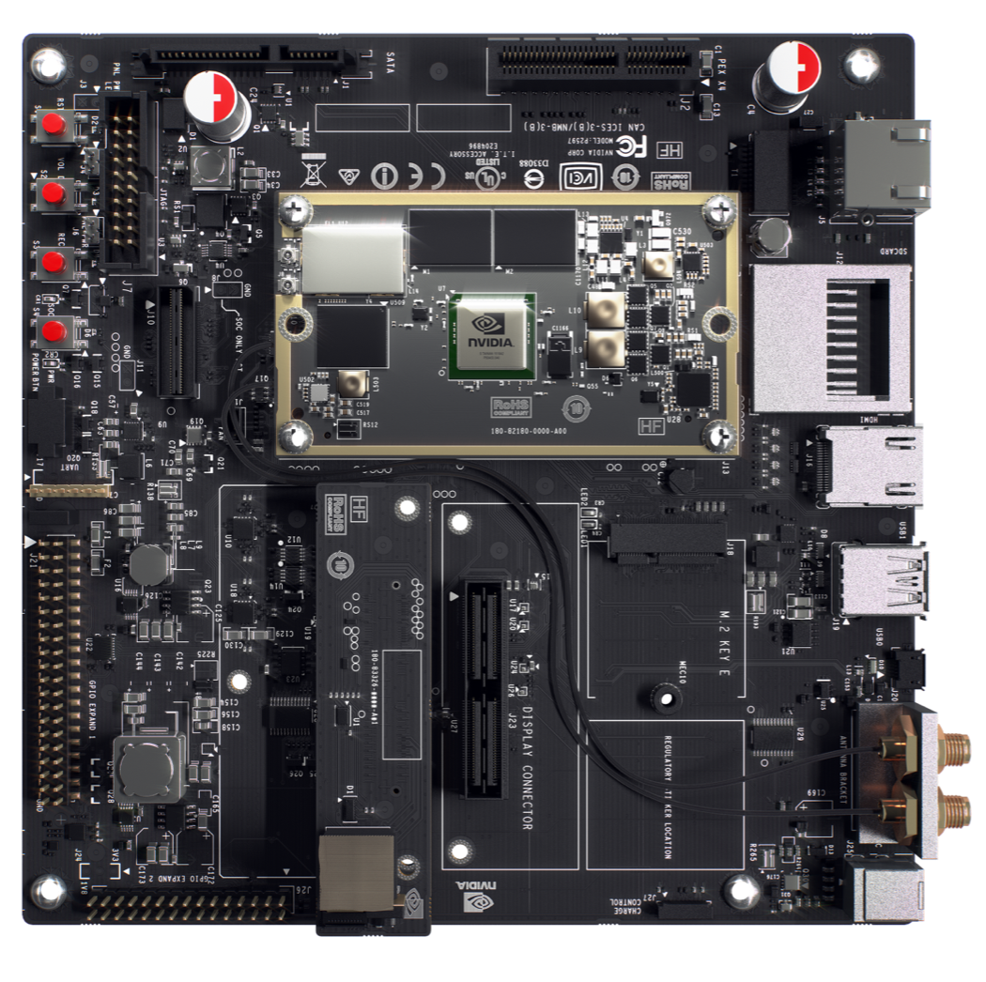
Jetson TX1 Developer Kit
Jetson TX1
Developer Board
5MP Camera
Notes:
So how do you get started with the Jetson TX1? This is the Jetson TX1 Developer Kit. It includes the Jetson TX1, a carrier board to break out all of the I/O, and a 5 MP camera. This is the system that developers will use to get started with Jetson TX1. Then when they’re ready to build their final product, they purchase individual Jetson TX1 modules, and build their custom solution around it. The Jetson TX1 developer kit is also a reference design for those custom solutions. If you’re familiar with the Jetson TK1 developer kit, this is very similar in capabilites. I’ll highlight the differences. First, as I’ve been saying, we built a module. For the previous generation a developer would start with the Jetson TK1 Developer Kit for development, and for production of their product they would by Tegra chips. For Jetson TX1, they start with the Jetson TX1 developer kit, and for production of their product they buy jetson TX1 modules. We did this to simplify things. All of the hard things to develop in a system like power sequencing and laying out memory. It doesn’t make sense for every customer to have to repeat that exercise. So why not encapluate it on a module? Second difference is performance. Going from Jetson TK1 to TX1 anywhere from a 2x – 3x speedup, depending on the application. Finally, we listened to the feedback we saw from the community and added WiFi and Bluetooth, added a CSI camera, and made the general purpose I/O easier to use by adding a way to set it to 3.3V, and including more. There’s also a x4 Gen2 PCIe slot. Besides those things, it’s largely similar to the Jetson TK1 devkit.

Slide 9
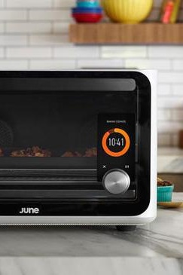
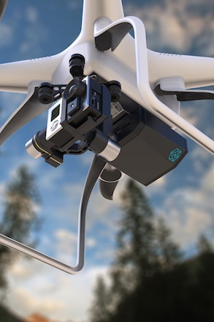
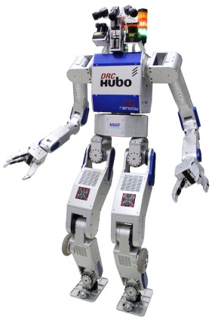
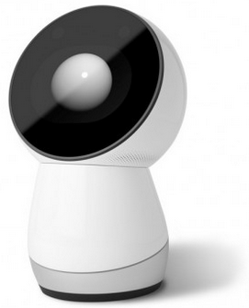
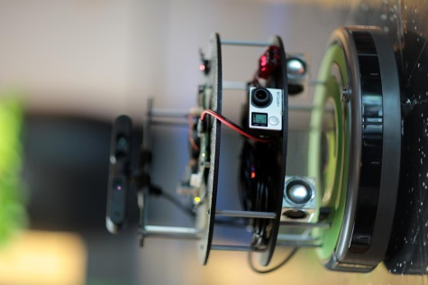
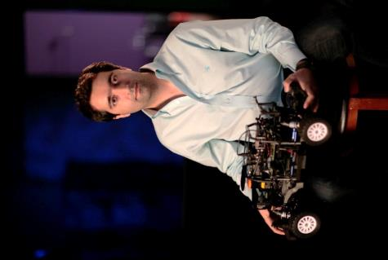
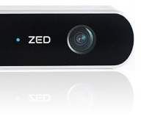
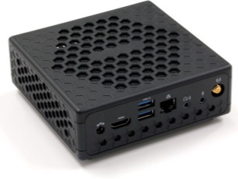

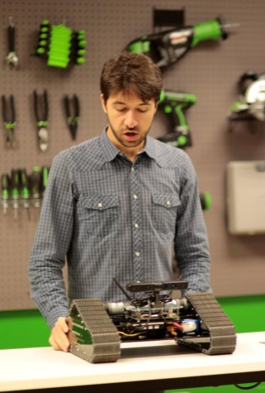
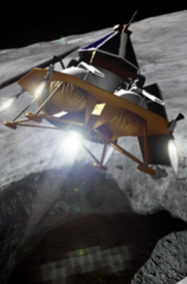
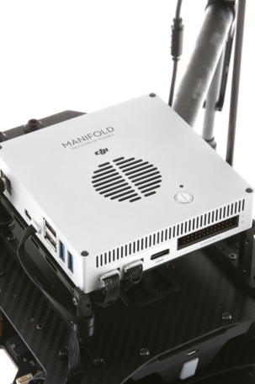
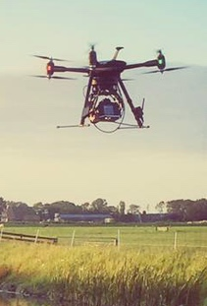
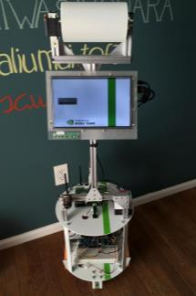
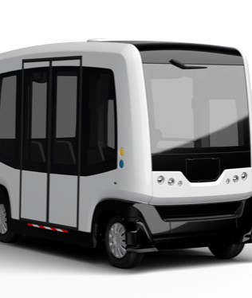
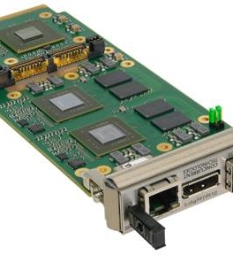
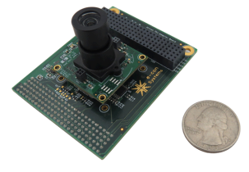
Jetson At the leading Edge Research Humanoids, Intelligent Appliances, Assistive and Medical Drones, Ground Robots, Submersibles
Notes:
These are all 3rd party platforms that integrate Jetson into their project or product. Jetson developers are deploying everything from research humanoids to social robots and self-flying drones, to autonomous spacecraft. The one thing that unites them all, is they each require maximum computational performance for onboard sensing in minimum size, weight, and power envelope.
Why did we build it?
---------
Jetson is NVIDIA’s platform for embedded visual computing. We launched Jetson a year-and-a-half ago with The Jetson TK1 Developer kit. We built it those people looking for the very best performance for visual computing in the embedded space. Researchers, OEMs, ISVs and IHVs, and Makers turn to Jetson when they need the best computer vision, the best graphics, the best GPU computing under 10W. You may have heard of examples. Jibo is the worlds first personal robot. Based on Jetson. Jibo has a camera so it can learn about you and your habits and helps organize, simplify, and enrich your life. The June oven was announced earlier this year: it uses computer vision and deep learning to help anyone improve their cooking abilities. And just this week DJI announced the Manifold, a Jetson-based computer vision box for the Matrice 100. From Products, to research, to ecosystem, Jetson is a powerful, efficient, and accessible platform. And by the way, we’re going to send you these slides and include references for what each of the above images is in case you’d like tolearn more.

Slide 10
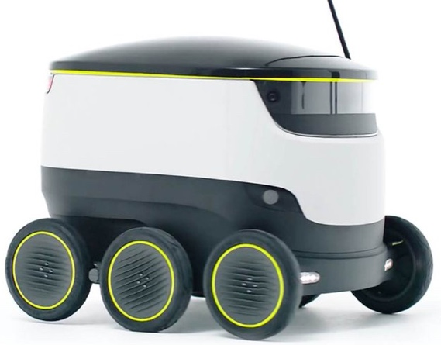
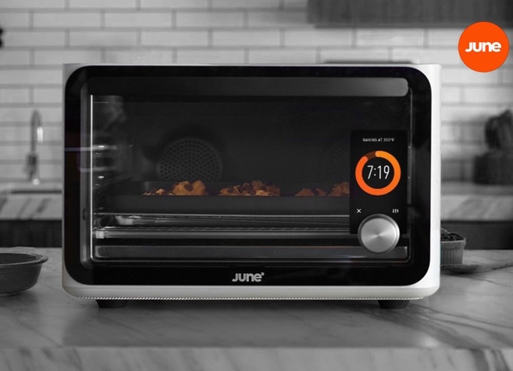
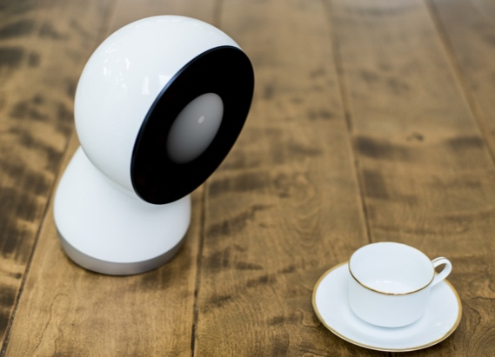
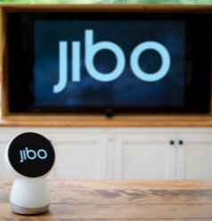
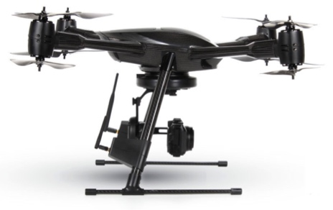


Jetson-Enabled Bots
Products and Prototypes with Jetson TK1
Starship delivery service
Household appliances
Jibo
June Intelligent Oven
Drones (consumer and industrial)
DJI Manifold for Matrice M100
Percepto, Aeryon, Aerialtronics
Prototype: Kespry drones with offline inference for outdoor asset tracking
Notes:
These bots all use Jetson TK1 to provide advanced capabilities and features, mainly through high-performance sensor processing and it’s derivatives. The Starship delivery service is a 6WD autonomous-navigating rover for delivering packages around town. I for one, can’t wait to get pizza or curry delivered with this thing. Right now they are running a field trial in London.

Slide 11
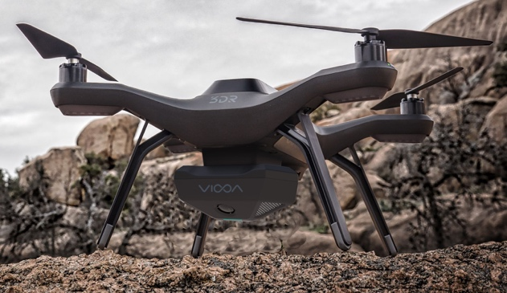
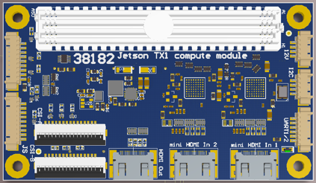
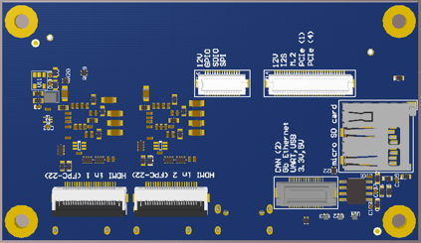
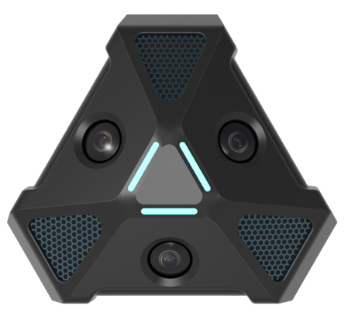
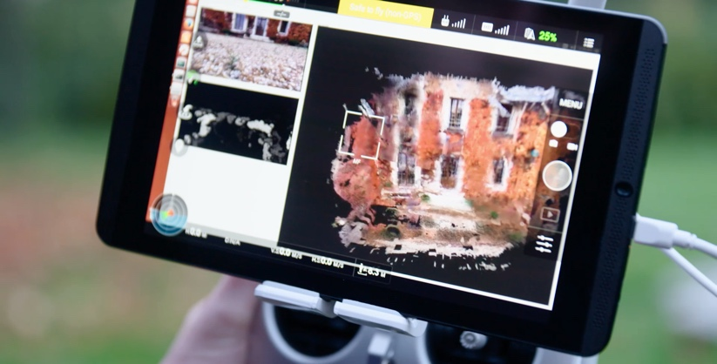
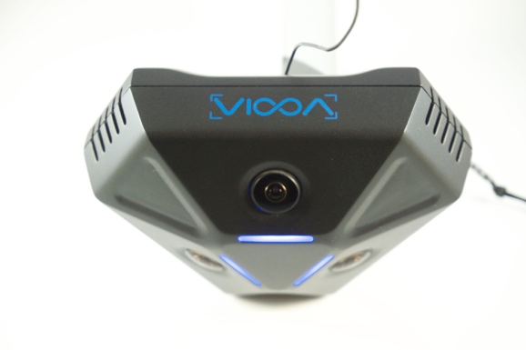
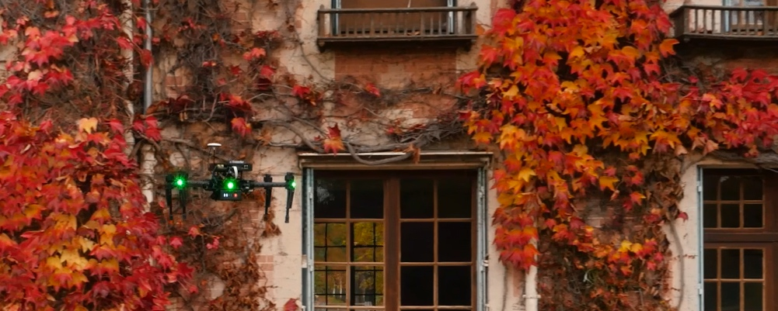
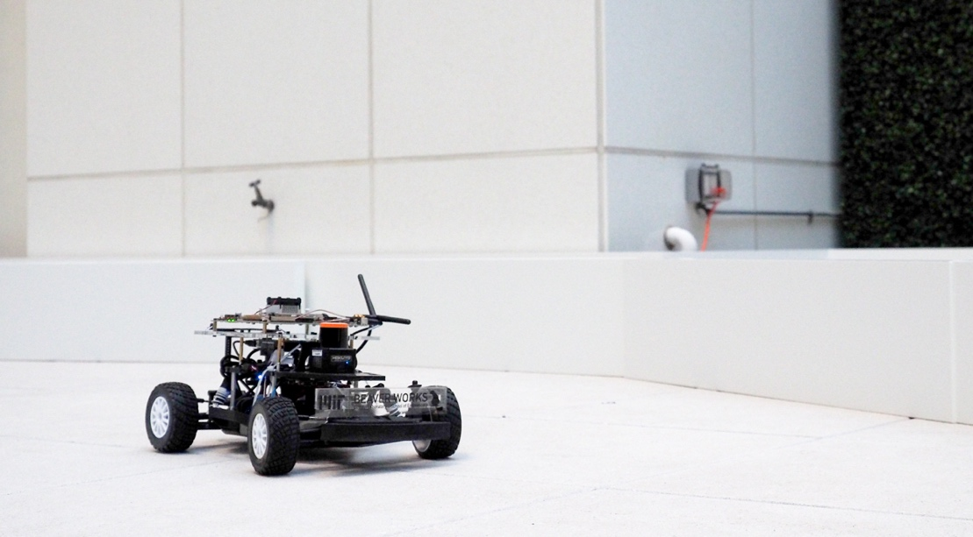
Jetson-enabled Bots
Jetson TX1 Inside
Stereolabs ZED drone
MIT self-driving racecar
Viooa 360° camera pod
DIYDrones mini carrier
More coming soon!
Notes:
Although Jetson TX1 just launched in mid-November, some folks have already started testing and deploying it on their platforms.

Slide 12
GPUS Solve Previously UNSolvable Problems
Notes:
Let’s take a look at the extensive tools & support ecosystem built around Jetson.

Slide 13
How far has autonomy come?
ImageNet classification accuracy
Deep Learning on GPUs
Notes:
A big part of Jetson TX1 is deep learning. Is everybody familiar with deep learning? Deep Learning is a neural-network based approach to machine learning. What distinguishes it from previous approaches is that it enables you to train very large data sets. This results is much more accurate performance for things like image classification, natural language processing, and medical diagnosis. There are three things that make this possible. First is the existence of large datasets for training. With the proliferation of cameras and big data solutions, there is simply more data for training neural networks. The second is new algorithms that train the networks far more efficiently. And the third is GPUs. These new algorithms are parallel in nature, and you need a general purpose, highly parallelized architecture to take advantage of them. As a proof point of the power of deep learning, there is a challenge known as the imagenet challenge that started 6 years ago. The challenge is to classify objects in images, like cocker spaniels, bicycles, etc. When it started in 2010 everybody was using traditional computer vision approaches, and the accuracy was only 72%. That means that 28% of the time the computer wrongly identified the object in the image. Humans have an error rate of about 5% by the way. After a year of optimization and improvements they managed to eek out another 2 percentage points. Deep learning arrived on the scene in 2012 as a new approach to image classification. In one year they reduced error rates by nearly 40%, and every year that continued to improve. This year both Google and Microsoft announced deep-learning based approaches that beat human performance on the Imagenet challenge. Sometimes I have to step back and remind myself what an incredible result that is. What does a world look like where computers can understand visual data better than humans.
So I don’t want to spend too much time on the background of deep learning, and NVIDIA has a lot of great information posted on Deep Learning, but the key points I want to make are this:
Deep Learning is enabling people to solve problems in computer vision and related areas that were previously unsolvable.
Everyone who is doing serious deep learning is using GPUs.

Slide 14

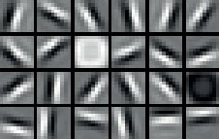
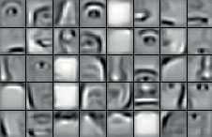
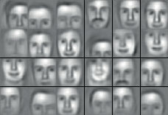
Machine Learning using Deep Neural Networks
Today’s Largest Networks:
~10 layers
1B parameters
10M images
~30 Exaflops
~30 GPU days
Human brain has trillions of parameters – 1,000 more.
Input
Result
Notes:
Let’s take a look at what’s driving a lot of the activity in this space. A big part of the capabilities of Jetson TX1 are around providing onboard inference and deep learning. I’m sure by now, everybody is familiar with, or has at least heard of, deep learning. In recent years there’s been a resurgence of activity in the area of neural-networks, enabled by accelerated training on large GPUs like NVIDIA’s Tesla and TitanX. In fact, the training has become so accelerated, it allows scientists to nest and pipeline several highly-complex networks, coining the phrase “deep” learning. What used to take weeks or months to train can now be trained on GPUs in hours or in a day. We still have a long way to go before we reach the computational complexity and efficiency of the human brain, or most biological nervous systems for that matter, but we’re getting there.
------
Recently however there’s been a revival of an old approach but with a few new twists – Neural Networks
Proposed in the 1950s
Boom-bust cycles of hype/disappointment, but incremental progress
Two things changed:
1) More sophisticated “deep” models with levels of abstraction
2) Availability of more training data
Let’s use face recognition as an example to illustrate the approach
From low-level features (edges) to higher levels of abstraction (facial features) to highest level of abstraction (complete faces)
Identifies features that aren’t intuitive – lets discriminatory features emerge from the data
Today’s largest networks train for weeks, and consume massive amounts of computational cycles
Takeaways – a lot of interesting properties for this approach
Not use-case specific – nothing in the algorithm assumes the data was image-based
Robust – lots of research showing resilience to errors and noise
Scalable – results improve with a) more training data, b) large models (more parameters)
Successful – ultimately nobody would care if it didn’t work better than other approaches

Slide 15


Train, then Deploy your Neural networks
Programming Approaches
Append and Augment Existing Dataset
Classified Object!
Camera Inputs
Network Link to Remote Server
Training: Server, GRID, DIGITS
Inference: Embedded (Jetson)
(and optionally training)
Solver
Network
Trained Deep Neural Net Model
Data Scientist
Notes:
Training isn’t the only aspect of deep learning that GPUs are accelerating. In the field, developers are deploying Jetson to host the runtime evaluation and inference capability onboard, as opposed to in the cloud. This decreases or eliminates the lag between events occurring in the environment and the response of the autonomous machine. You can quickly train your network on a larger NVIDIA GPU and then deploy that network on the size, weigh, and power-efficient Jetson module. Also not pictured here, but a lot of times Jetson is also used on the front-end data capture for the training data, because it contains high-end H.265 video encoders and SATA and PCIe interfaces for high-speed storage. And down the road, we are shortening the loop between collection, training, and inference by exploring onboard on-the-fly learning in realtime and alternative neural networks such as RNNs and LSTMs, which are Turing complete and can essentially encode an entire complex program in the network.
-----
So what does that mean for autonomous machines? Most of what I’ve talked about so far pertains to big GPUs in the cloud or in high performance workstations. There’s actually a great story here for autonomous machines, and I’ll explain why. There are two parts of the deep learning problem. The first is training. You show the computer lots of data, for instance tens of thousands of images of cocker spaniels and bicycles. This can take hours or days and runs on a server, like a product that NVIDIA sells called the Digits Devbox, but when its done you have a network that knows what these things look like. You can now show it new images that it has never seen before, and it can tell you what they are. This is inference, the second part of the problem. And it turns out that inference, while still computationally intensive, can fit in a Jetson TX1. You train your network on Digits, or on AWS, or whatever you preferred GPU-enabled solution is. You deploy your network onto Jetson TX1. Now your drone, your robot, your smart security system is recognizing animals, vehicles, and people, doing natural language processing, or any of the other applications for which deep learning is proving a great solution.
To clarify: dotted lines…location of camer inputs. REWORK!!!!

Slide 16
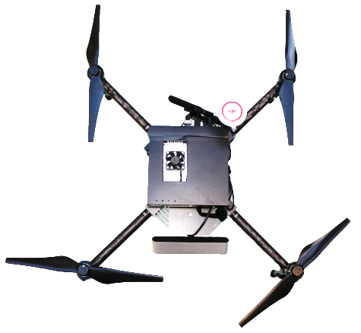

Object Classification
Segmentation
Collision Avoidance
3D Reconstruction
Localization/Mapping
Notes:
So what does this mean for autonomous machines? With deep learning, they are able to extend their own capabilities and provide inference for themselves. And this isn’t just limited to the 2D image classification that you’ve seen of late. There’s ground-breaking work going on, right here at CMU even, to extend the paradigm further into 3D and provide terrain segmentation, collision avoidance, and refined SLAM on the point cloud. And with RNNs and LSTMs coming into vogue, there’s practically no limit to onboard intelligence for higher-level learning and connectivity of conceptual semantics, i.e. the ability to infer ideas and concepts. And with the training/eval loop closing to the point of on-the-fly learning onboard the platform, the possibilities are truly exciting.

Slide 17
NVIDIA Tools — Enable Rapid Development OF Autonomous systems
Notes:
Let’s take a look at the extensive tools & support ecosystem built around Jetson.

Slide 18











Jetson Linux SDK
Deep Learning and
Computer Vision
GPU Compute
Graphics
Developer Tools
NVTX
NVIDIA Tools eXtension
Debugger | Profiler | System Trace
Notes:
The Jetson BSP is built upon Linux, currently Ubuntu 14.04 LTS, with the full support of CUDA Toolkit and all of it’s associated libraries. In addition, there’s VisionWorks and a suite of performance profiling, analysis, and debugging tools for the Tegra SoC.
[NEED TO RESTORE GRAPHICS PANE!]

Slide 19



















Jetson SDK: The Components
Vertically
Integrated
Packaages
Vertically Integrated Packages:
CUDA
OpenGL
Tools:
Machine
Learning
Vision
Source
code editor
cuFFT
CUDA Math Library
Debugger
Compute
cuBLAS
NPP
cuSPARSE
Graphics
Profiler
cuRAND
Thrust
cuSolver
System
Trace
Linux for
Tegra
V4L2
libjpeg
NVTX
NVIDIA Tools eXtension
Jetson TX1
Notes:
Here’s a look at the API’s you get out-of-the-box. Jetpack, our board flashing tool, will optionally install these upon a fresh image load. There’s everything you need to get started and more, from OpenCV4Tegra to cuDNN and Caffe.

Slide 20









VisionWorks™
CUDA-accelerated Computer Vision Toolkit
Full OpenVX 1.1 implementation
Custom, additional extensions (superset)
Easy integration with existing CV pipelines
Robotics
Augmented Reality
Drones
Example
Applications
Applications
Feature Tracking
Structure from Motion
Object Tracking
Dense Optical Flow
VisionWorks
VisionWorks™ API + FrameWorks
CUDA
VisionWorks™
Toolkit
IMAGE ARITHMETIC
Absolute Difference Accumulate Image
Accumulate Squared
Accumulate Weighted
Add / Subtract / Multiply
Channel Combine
Channel Extract
GEOMETRIC TRANSFORMS
Affine Warp +
Perspective Warp
Flip Image
Gaussian Pyramid
Remap
Scale Image
Features
Canny Edge Detector
Fast Corners +
Fast Track
Harris Corners +
Harris Track
Hough Circles
Hough Lines
Jetson TX1
Notes:
High-level VisionWorks primitives include:
FAST corner extraction + matching
LTK optical flow
SLAM
Stereo block matching
and more!

Slide 21
VisionWorks™ Primitives
IMAGE ARITHMETIC
Absolute Difference
Accumulate Image
Accumulate Squared
Accumulate Weighted
Add / Subtract / Multiply
Channel Combine
Channel Extract
Color Convert +
CopyImage
Convert Depth
Magnitude
Not / Or / And / Xor
Phase
Table Lookup
Threshold
FLOW & DEPTH
Median Flow
Optical Flow (LK)
Semi-Global Matching
Stereo Block Matching
GEOMETRIC TRANSFORMS
Affine Warp +
Warp Perspective +
Flip Image
Remap
Scale Image +
FILTERS
BoxFilter
Convolution
Dilation Filter
Erosion Filter
Gaussian Filter
Gaussian Pyramid
Laplacian3x3
Median Filter
Scharr3x3
Sobel 3x3
FEATURES
Canny Edge Detector
Fast Corners +
Fast Track
Harris Corners +
Harris Track
Hough Circles
Hough Lines
ANALYSIS
Histogram
Histogram Equalization
Integral Image
Mean Std Deviation
Min Max Locations
All OpenVX Primitives
NVIDIA extensions
+ type/mode extension by NVIDIA
NVIDIA extension primitives
Notes:
VisionWorks Toolkit implements all of OpenVX primitives, defined in 1.0.1 version of the standard specification, and an additional 10 NVIDIA defined extensions.
VisionWorks primitives can be categorized as
Image Arithmetic functions,
Flow and depth processing functions,
Geometric transforms,
Filters,
Features and
Analysis functions.
The functions marked in green are NVIDIA extensions. The functions marked with “+” are OpenVX defined functions further extended by NVIDIA for different data types and modes of operation.
Vision API is fully accelerated with CUDA. Part of the Vision API is also accelerated on the Tegra CPUs with NEON and multithreading.

Slide 22


cuDNN
CUDA-accelerated Deep Learning library
Supports industry-standard frameworks:
Out-of-the-box speedups of neural networks:
For both Inference and Training:
Your Application
(dog breed detector, for example)
Frameworks
cuDNN
CUDA
Jetson TX1 // Tesla/Titan/GRID
Notes:
Couple of things I want to highlight from the Jetson SDK. This is a high performance platform and we make it easy…

Slide 23


Robot Operating System (ROS)
What is it?
Standardized package manager
ROS packages run on Ubuntu (by default)
Standardizes message-protocols for:
Pose estimation
Localization
Navigation
Computer vision
Incorporates the latest contributions from academia (bleeding-edge research)
Andrew Symington, UCL Gazebo and rviz with several quadrotors, ROSCon 2014

Slide 24


Robot Operating System (ROS)
What’s next?
Message-passing interface now designed to work with lossy protocols and embedded microcontrollers
Focus on ‘robust’ components
and also ‘experimental’ components
Code quality control and vetting process
2D SLAM using Kinect depth data in rviz for autonomous navigation
David Lu, UCL Layered costmaps in rviz, ROSCon 2014

Slide 25


Peripherals Jetson ConnectS with
including Community Contributions
Infrared devices:
SICK LIDAR (LMS 200); Hokuyo
Asus Xtion Pro Live (PrimeSense)
Intel RealSense
Stereo and color cameras:
StereoLabs Zed (consumer-oriented)
Point Grey Research USB3 and GigE
e-con Systems CSI-MIPI Cameras with external ISP
Notes:
Here are some example pre-integrated devices that are known to work in the Jetson community. The ZED we are using on our project robot. But really any device with standard interface like USB, serial, I2C, SPI, etcetera is plug and play. It’s a big step for usability of ARM architectures.

Slide 26

eLinux wiki
Notes:
Further, we have a developer-friendly website set up which contains all the docs and downloads. For Jetson TX1, we released thousands of pages of documentation to go along with the board. It’s a sea change for vendors to offer open-access into the depths of their historically guarded SoC’s. To NVIDIA, it’s important to get this technology into the hands of developers everywhere without exception.

Slide 27



JETSON TX1 — BLOCK DIAGRAM
—
Schematics, Layouts
—
Notes:
Here’s a high-level block diagram of the Tegra X1 SoC. The Jetson module’s pinout very closely mimics the TX1’s capabilities. The complexity of modern-day system-on-chips exceeds that of a Saturn V rocket. It’s a true embedded system. There are so many functional units operating asynchronously within a chip half the size of a postage stamp, that when the software layers are added in, it reaches almost bewildering complexity.
The important bit is the CUDA engine, which allows users to easily harness the full 1024 GFLOPS of performance for general-purpose GPU applications like high-bandwidth video, image, and signal processing, complex maths, and DSP.

Slide 28





Jetson TX1 Developer Kit
$599 retail
$299 educational discount
Started Shipping Nov 16 (US)
Int’l to follow

Slide 29
Jetson TX1 Module
$299 Available 1Q16
Distributors Worldwide
(1000 unit QTY)

Slide 30
ONE ARCHITECTURE — END-TO-END AI
PC GAMING
CUDA + Linux throughout the stack.
Notes:
Again, Jetson is code-compatible across the NVIDIA ecosystem, and if you develop an application on your laptop or desktop with NVIDIA GPU, you can scale that application and easily deploy it into the field, which is unheard of, to go from a 250W processor to a 10W processor without changing the code.

Slide 31

Thank you! Q&A: What can I help you Build?

Slide 32




TURBo2 — DEEP LEARNING PLATFORM
Notes:
Tegra Unmanned Recon Bot

Slide 33


Slide 34
SSD
12V reg
USB hub
motor drivers
JTX1
voltage sensor
5V reg
analog I/O
24V motors

Slide 35


Cmu VOXNET

Slide 36




Cmu VOXNET

Slide 37
Thank you! Q&A: What can I help you Build?

